Slide 1
Computer Graphics (L12) EG678EX
Visible Surface Detection
Prepared By: Dipesh Gautam
‹#›

Slide 2
Visible Surface Detection
Two approaches
Depends upon object definition or projected image
Object-space
Compares objects and parts of objects to each other within the scene
Image-space
Visibility is decided point by point at each pixel position on projected plane
Prepared By: Dipesh Gautam
‹#›

Slide 3


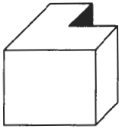
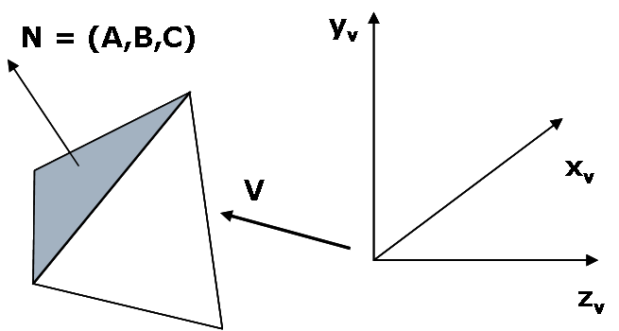
Back Face Detection Method
N
V
The test could be simplified by considering normal vector N = (A,B,C) to polygon surface and Vector V in viewing direction as:
the polygon is back face if: V.N>0
If object description is converted to viewing co-ordinates then, V is along z_{v} axis i.e V = (0,0,V_{z}), then:
V.N = V_{z}C
i.e V.N > 0 🡪 V_{z}C
So we need to consider only sign of C
For right handed viewing system with viewing direction along negative z_{v} axis, c<0 🡪 back face
What if C = 0 ??
Grazing Viewing i.e viewing direction is perpendicular to surface normal🡪 also back face
So, back face if C≤0
Prepared By: Dipesh Gautam
‹#›

Slide 4
Depth Buffer (z-Buffer) method
Image-space method
Surface depth is compared at each pixel position on the projection plane
Usually applied to scene containing only polygon surfaces; but possible to apply for non-planar surfaces
For each pixel position (x,y) on projection plane, object depths can be compared by comparing z-values as each (x,y,z) position on a polygon surface corresponds to the orthographic projection point (x,y) on projection plane
Two buffers required
Depth buffer: to store depth value for each position
Refresh buffer: to store intensity values of each position
Drawback: Deals only with opaque surface but not with transparent surface
Prepared By: Dipesh Gautam
‹#›

Slide 5
Depth Buffer (contd…)
Initialize the depth buffer and refresh buffer so that for all buffer positions (x,y),
depth(x,y) = 0, refresh(x,y) = I_{backgrnd}
For each position on each polygon surface, compare depth values to previously stored values in the depth buffer to determine visibility
Calculate the depth z for each (x,y) position on the polygon
If z>depth(x,y), then set
depth(x,y)=z, refresh(x,y)=I_{surf}(x,y)
s₃
s₂
s₁
y_{v}
(x,y)
x_{v}
I_{backgrnd} = background intensity
I_{surf}(x,y) = projected intensity value for the surface at pixel position (x,y)
z_{v}
Prepared By: Dipesh Gautam
‹#›

Slide 6
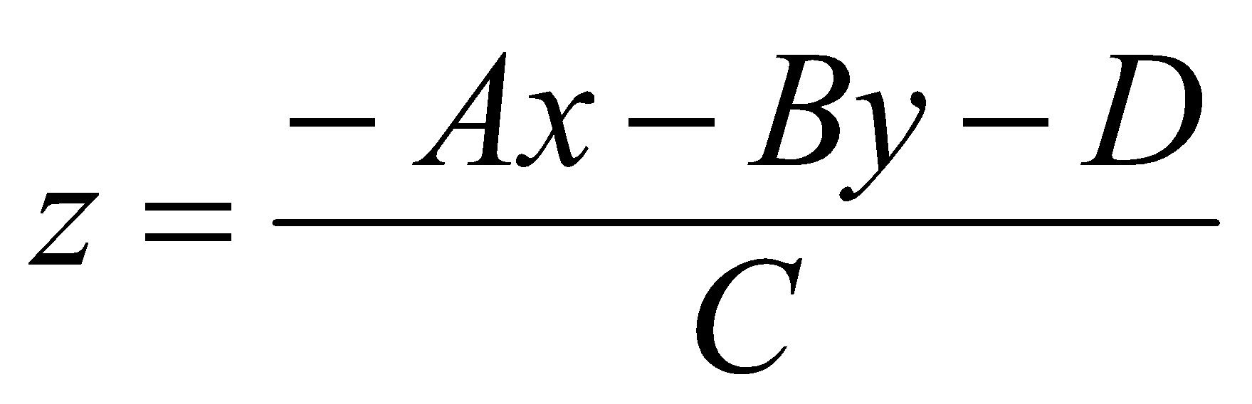
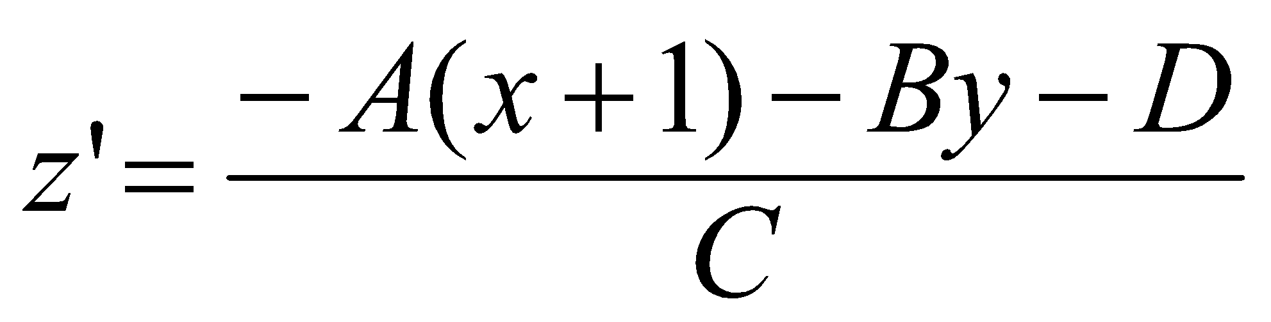
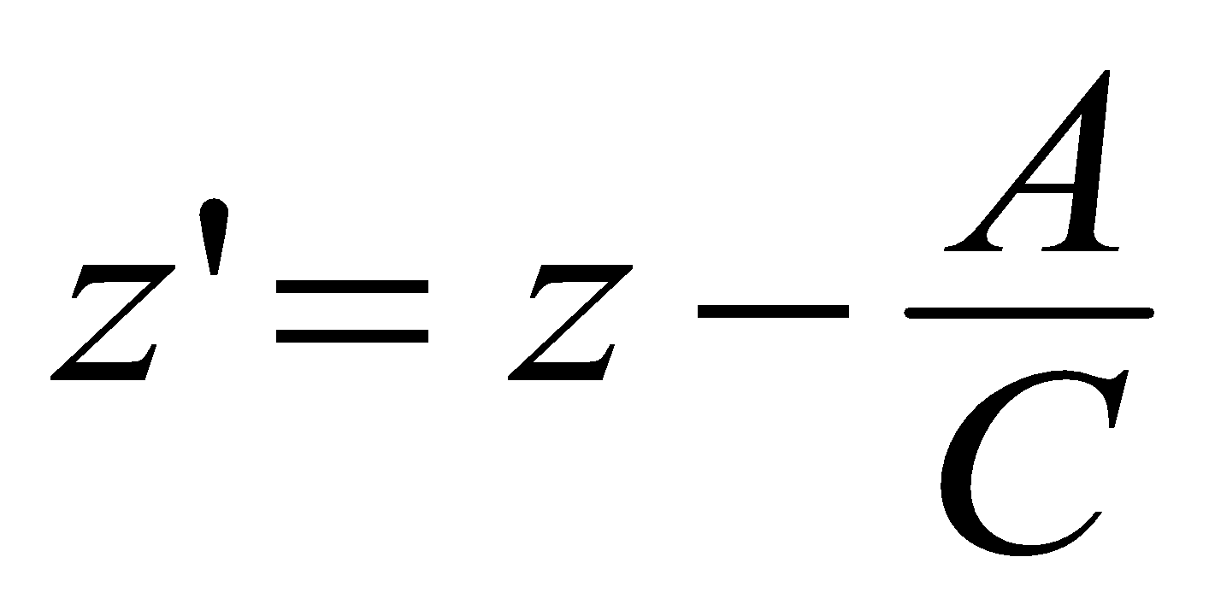
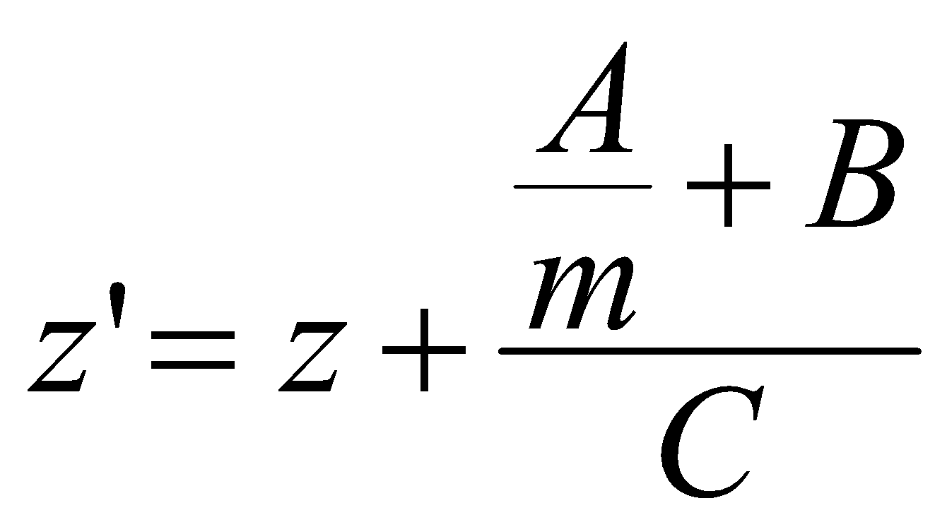
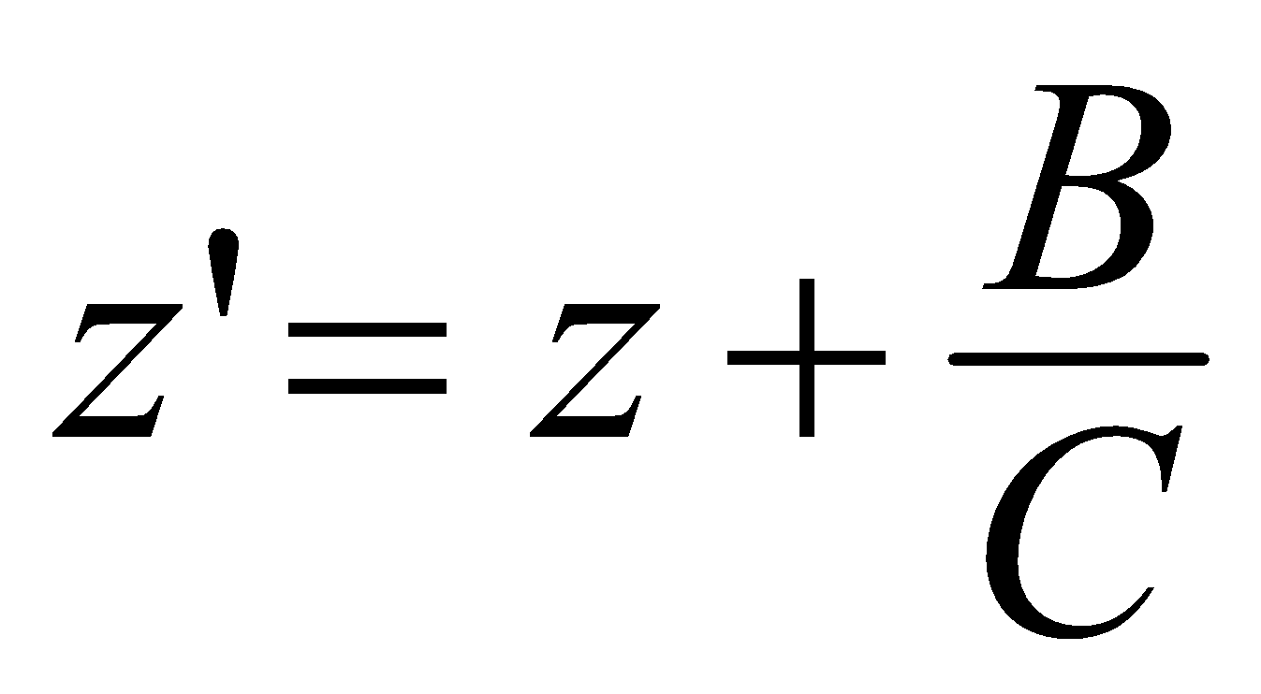
Depth Buffer (depth calculation)
From plane equation, depth is
For the next adjacent pixel in a scan line, depth is
Determine minimum and maximum y-coordinates for each polygon
Start from top scan line to bottom scan line
Starting from top vertex, calculate x position down the left edge of the polygon recursively as
x’ = x – 1/m
Thus depth value for the next pixel in left edge is obtained as
For vertical edge m = infinity, so:
y
y-1
or
x
x+1
top scan line’
y scan line
left edge intersection
m(x’-x)=y’-y=-1
bottom scan line
put x’ = x-1/m and y’ = y-1
y scan line’
y-1 scan line’
x
X’
Prepared By: Dipesh Gautam
‹#›

Slide 7
A-Buffer Method
background
opaque
surface
foreground
transparent
surface
Extension of depth buffer method
Antialiased, area-average, accumulation-buffer
The depth buffer is expanded so that each position in the buffer can reference a linked list of surfaces thus enabling more than one surface intensity consideration
The object boundary could be antialiased
Each pixel position in the A-Buffer has two fields
Depth Field 🡪 stores a positive or negative real number
Positive🡪 single surface contributes to pixel intensity
Negative 🡪 multiple surfaces contribute to pixel intensity
Intensity Field 🡪 stores surface-intensity information or a pointer value
Surface intensity if single surface 🡪 stores the RGB components of the surface color at that point and percent of pixel coverage
Pointer value if multiple surfaces
in case of surface linked list, the data for each surface in the linked list includes
RGB intensity
Opacity parameter
Depth
Percent of area coverage
Surface identifier
Other surface-rendering parameters
Pointer to next surface
Scanlines are processed to determine surface overlaps of pixels across the individual scanlines.
Surfaces are subdivided into a polygon mesh and clipped against the pixel boundaries
The opacity factors and percent of surface overlaps are used to determine the pixel intensity as an average of the contribution from the overlapping surfaces
d>0
I
depth
field
intensity
field
d<0
Surf1
Surf2
depth
field
intensity
field
Prepared By: Dipesh Gautam
‹#›

Slide 8
Scan-Line Method
Extension of scanline algorithm for filling polygon interiors
Instead of filling just one surface, we deal with multiple surfaces
Construct edge tables and polygon tables
Edge table contains 🡪 endpoints of each edge in the scene, inverse slope of each line and pointers to the polygon table to identify its corresponding surface
Polygon table contains 🡪 plane equation coefficients, surface intensity, pointers to the edge table (optional)
Setup an active list (why active ??) of edges for those edges which cross the current scan line
The edges are sorted in order of increasing x
Define flags for each surface to indicate whether a position is inside or outside the surface
At leftmost boundary of surface flag == on and at rightmost boundary flag == off
Prepared By: Dipesh Gautam
‹#›

Slide 9
Scan-Line Method (contd…)
B
E
For scan line 1
The active edge list contains edges AB,BC,EH, FG
Between edges AB and BC, only flags for s1 == on and between edges EH and FG, only flags for s2==on
no depth calculation needed and corresponding surface intensities are entered in refresh buffer
For scan line 2
The active edge list contains edges AD,EH,BC and FG
Between edges AD and EH, only the flag for surface s1 == on
Between edges EH and BC flags for both surfaces == on
Depth calculation (using plane coefficients) is needed.
In this example depth for s1 is less than for s2, so intensities for surface s1 are loaded into the refresh buffer until boundary BC is encountered
Between edges BC and FG flag for s1 == off and flag for s2 == on
Intensities for s2 are loaded on refresh buffer
For scan line 3
Same coherent property as scan line 2 as noticed from active list, so no depth calculation needed between edges BC and EH
y_{v}
F
A
Scan Line 1
S1
S2
Scan Line 2
Scan Line 3
H
C
D
G
x_{v}
Prepared By: Dipesh Gautam
‹#›

Slide 10
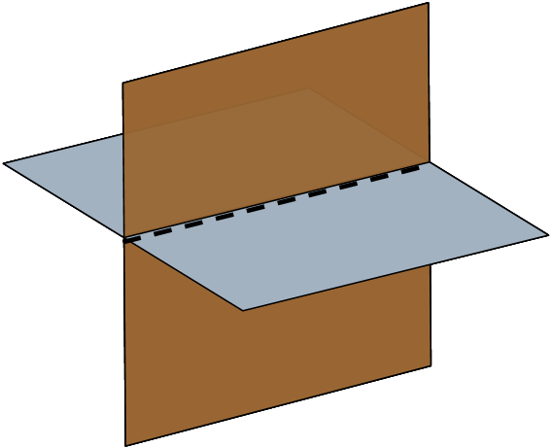
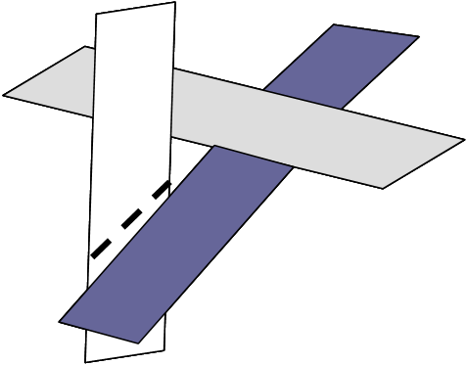
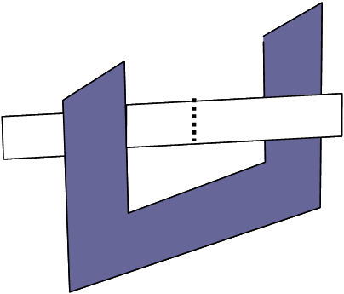
Scan-Line Method (contd…)
Problem: Dealing with cut through surfaces and cyclic overlap is problematic when used coherent properties
Solution: Divide the surface to eliminate the overlap or cut through
Subdividing line
Subdividing line
y_{v}
E
B
F
Scan Line 1
A
Scan Line 2
Subdividing line
S1
S2
Scan Line 3
Scan Line 4
H
C
D
G
x_{v}
Prepared By: Dipesh Gautam
‹#›

